Slide 1
Inlay Resurfacing Arthroplasty
Phil Davidson, M.D.
Davidson Orthopaedics
Park City, Utah
Boise, ID April 20, 2017

Slide 2
OUTLINE
Perspective on resurfacing
Indications – Spectrum of Pathologies
Introduction of Inlay Arthroplasty Concept
Biomechanical Basis
Knee & Shoulder
Techniques
Cases
Results

Slide 3
WHAT WOULD YOU DO?? 49 yr old f, no laxity, anterior only VAS 5-8 pain, >10 yrs worsening, TT-TG 14, no response to non-op measures, pain now limiting ADL

Slide 5
Treatment Options
Further meds, modify activity, Defer TKA
Scope, debride, lat release
Scope, debride, realign
Traditional Onlay PFA
Inlay PFA, realign
Other

Slide 6
Cartilage Restoration and Joint Resurfacing A wide realm between…..
Arthroscopic
debridement

Slide 7
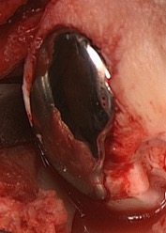
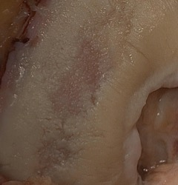
Theme Cartilage Restoration and Joint Resurfacing
Spectrum of Pathology
Individualize according to the specific patient
Wide array of treatment options
Biologic Restoration in youth, when possible
Appropriate Minimally Invasive Prostheses
Continually incorporating new technologies

Slide 8
How do we systematically, scientifically and effectively get a handle on these challenging cases?
31 year old UPS worker
39 year old female ski guide

Slide 9
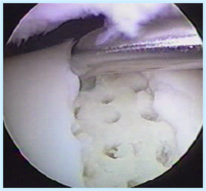
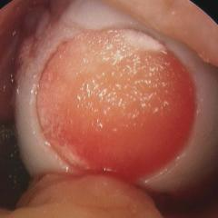
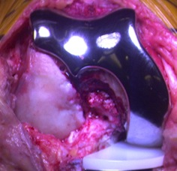
Joint Restoration Treatments: …an evolving continuum of options, biological thru prosthetic
Debridement
Marrow stimulation
Biological restoration
Biologic grafts
Biosynthetics
Scaffolds
Cellular therapy
Prosthetic Resurfacing
Bio-Prosthetic mix
Inlay Arthroplasty
Onlay Arthroplasty
Total Joint

Slide 10
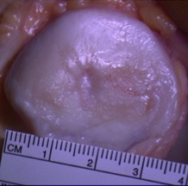
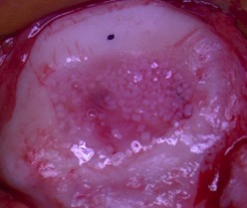
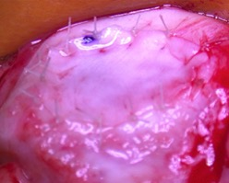
Biological Options
Cell Therapies
ACI
MACI
Stem cells
Nanofracture
Osteochondral Grafts
Autogenous
Allogeneic
Chondral grafts
Cartiform
Particulated
Biologically Active Scaffolds

Slide 11
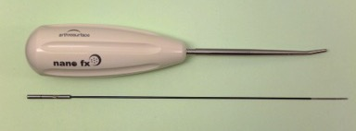
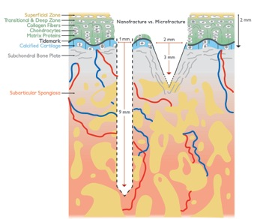
Nanofracture Modern “microfracture”
1x9mm channel
Little risk of subchondral fx
No thermal necrosis
Optimal access for MSCs
Ideal for femur, limited in patella

Slide 12
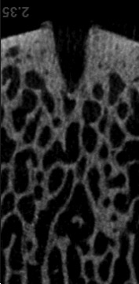
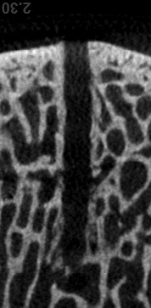
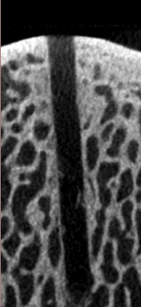
Microfracture Surface Diameter
2.5mm
Border with high regularity
Nanofracture Diameter
1mm
Border with low regularity
Open trabecular channel
K-Wire Diameter
1mm
Border with high regularity
Walsh WR et al. Surgical & Orthopaedic Research Laboratories (SORL) Prince of Wales Clinical School, Sydney, Australia.®

Slide 13
Biologic or Prosthetic Resurfacing ???? Key decision making point
Multifactoral decision
Lesion/Cartilage nearby
Patient Factors
Age (biological)
Comorbidities
Joint Status
Resources

Slide 14
Decision Making – Bio vs. Prosthetic Lesion/Cartilage Nearby
Health of nearby cartilage can guide decision
Consider what is being preserved
Osteophytes are clearly sign of progressive degeneration which mitigates against a bio option

Slide 15
Decision Making – Bio vs. Prosthetic
Patient Factors
Expectations
Vocation
Activities, Athletics
Complicity
Age
Biological, not just chronological
Comorbidities
Systemic Arthritis, crystalline disease
BMI
Diabetes
Smoking
Medical Illness
34 year old cyclist

Slide 16
Decision Making – Bio vs. Prosthetic Joint Morphology
Biologic Solutions are less likely to work in joint which has lost contour
Mechanical stresses on bio surfaces must be taken into account
Is the joint “out of round” ?
osteophytes or flattening
Is the joint subluxed?
Not only prosthetic, but some constraint indicated

Slide 17
Radiographic Guide to Bio vs. Prosthetic
Kellgren-Lawrence Grading Scale
Generally Biological Resurfacing……
Grade 0 = Normal
Grade 1 = Doubtful narrowing of the joint space and possible osteophytic lipping
Grade 2 = Definite osteophytes, definite narrowing of the joint space
Generally Prosthetic Resurfacing…..
Grade 3 = Moderate multiple osteophytes, definite narrowing of joints space, some sclerosis and possible deformity of bone contour
Grade 4 = large osteophytes, marked narrowing of joint space, severe sclerosis and definite deformity of bone contour.
KL 2
KL 2

Slide 18
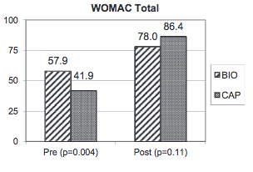
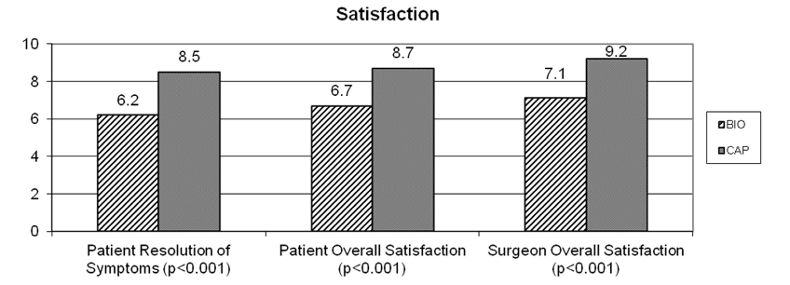
Age >35yrs, mean 44.6yrs
2 groups: 30 bio resurfacing, 32 CAP
2yr min f-u

Slide 19
Transitional thinking from biologics to prosthetics
Once progress in resurfacing algorithm from bio to prosthetic need conceptual framework
Inlay
Onlay
Bone sacrificing ( traditional)

Slide 20
Why Consider Resurfacing?
Need for bridging or intermediary procedure in younger patients
Preserve healthy anatomy in older patients
Increased burden of US TKA --- 4M with TKA, 1.5M between 50-69 yrs
Weinstein, JBJS March, 2013
15% of total knee patients have severe or extreme persistent pain three to four years post op.
Wylde V, Pain 2011
19% of middle aged patients were satisfied with the outcome of their total knee replacement
Bourne et al., Clin Orthop Relat Res 2010

Slide 21
Inlay Joint Resurfacing

Slide 22
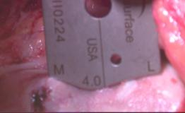
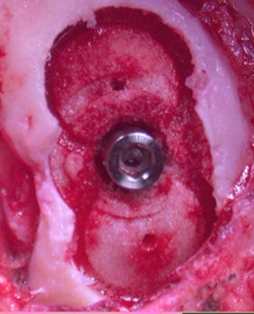
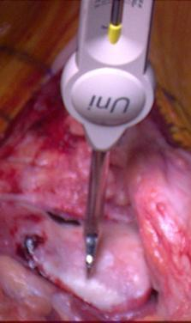
Inlay Resurfacing
Accommodates morphologic variability and size
Intraoperative Topographic mapping
Preserves anatomy, minimal bone resection
Truly an inset, therefore limited mechanical stress

Slide 23
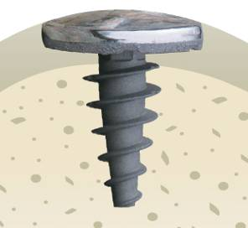
Introduction of CAP
Geometry based on patient’s native anatomy
Intraoperative joint mapping
Account for complex asymmetrical geometry
Extension of biological resurfacing

Slide 24
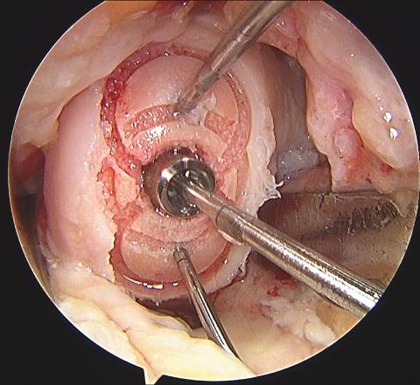
Patient Contour Match
Surface milling
Stable stud screw
Bone sparing
No encroachment

Slide 25
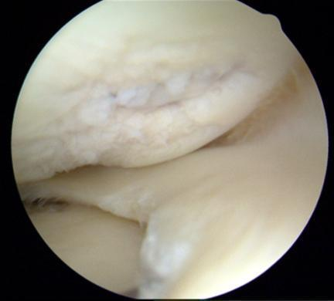
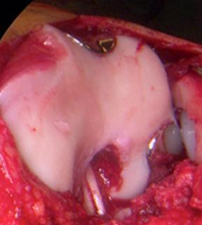
Inlay Resurfacing: Anatomical Reconstruction
Accommodate complicated curvatures
Minimally invasive procedure allows for concurrent reconstructions
Inlay Arthroplasty is intrinsically stable as it is literally inset. No edge loading.
Accounts for morphologic variability

Slide 26
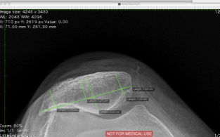
ANATOMY- Alignment
Must know alignment, potentially correct or accommodate with resurfacing
Must have long leg standing films available
For PF need Merchant view
CANNOT restore joint height with inlay implant

Slide 27
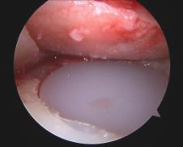
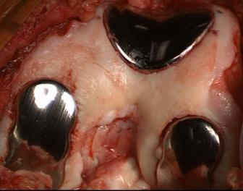
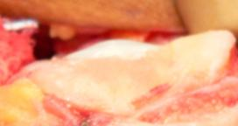
Inlay- Platform Technology
Multiple Joints
Multiple sizes and shapes
Metallic Inlay in conjunction with stud or set-screw
Poly Technology uses cement in socket to achieve congruity

Slide 28
Inlay Advantages
Able to restore mechanical “smoothness”
Alleviates pain
Avoid or limit propagation of chondral defects
Low volume, prevents encroachment on other parts of joint
Minimally invasive, low morbidity, outpatient procedure
Revision to subsequent arthroplasty is easy due to shallow implant bed with minimal bone resection
Ample room for ACL, osteotomy, soft tissue procedures
Relatively focal treatment preserving healthy adjacent anatomy

Slide 29
Inlay - Limitations and Concerns
No angular or height correction can be obtained with an inlay implant
Must accommodate or account for loss of ROM
Stiff knee- consider tissue releases, other choices
Must consider reciprocal surface, resurface if needed
Extensive tibial cartilage loss mandates onlay resurfacing to cover more of tibia
Be cautious and specific about referred pain and radiating pain patterns.

Slide 30
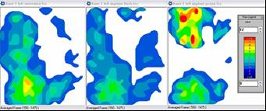
Reciprocal surface not stressed by implant if flush or slightly recessed Becher, C.;Huber,R.;Thermann, H.; Paessler, H.E.; Skrbensky, G.: Effects of a contoured articular prosthetic device on tibiofemoral peak contact pressure: a biomechanical study. Knee Surg Sports Traumatol Arthrosc. January; 16(1): 56–63. 2008
untreated knee flush HemiCAP® 1mm proud HemiCAP®
Anterior
Posterior

Slide 31
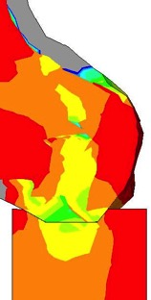
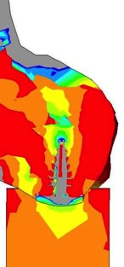
Finite Element - Analysis
Physiological
With HemiCAP
Conclusion:
No stress shielding
Effective load transmission into underlying bone

Slide 32
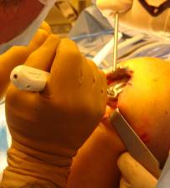
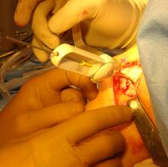
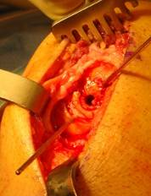
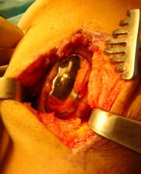
Inlay Arthroplasty: Tibiofemoral

Slide 33
Inlay Advantages vs Traditional Uni
UniCAP may prevent patello-femoral complications/encroachment of conventional UKA through inlay resurfacing
Revision to standard UKA may be possible due to shallow implant bed resurfacing technique
UniCAP avoids L-cut
Ample room for ACL, osteotomy, soft tissue procedures
Meniscal sparing technology for patients with healthy, functional meniscus

Slide 34
Inlay Limitations and Concerns
NO angular correction
Tibial surface:
Only for central lesions
More common lesions are peripheral, submeniscal
Extensive tibial chondral loss, need other option
Patient selection remains critical:
Treat all pathology in the knee – homeostasis
Be cautious and specific about referred pain and radiating pain patterns
Tibial pain is important to note!
Don’t want to undertreat tibia

Slide 35
UniCAP™- PUNI (femoral condyles) aka… inlay arthroplasty, scope assisted Uni, AKR , etc..

Slide 36
Cement- 2 good reasons 1. FDA 2. Pain relief

Slide 37
UniCAP case example – medial knee resurfacing 46 year old cyclist

Slide 38
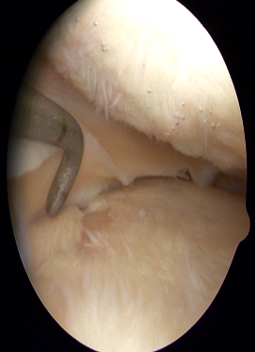
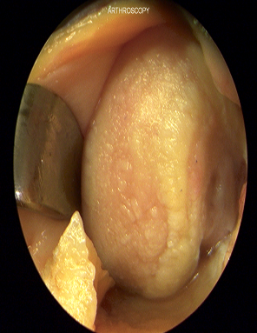
UniCAP – medial knee resurfacing

Slide 39
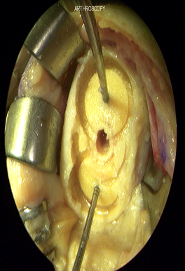
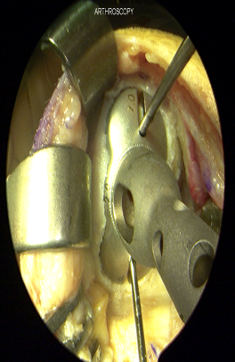
UniCAP – medial knee resurfacing

Slide 40
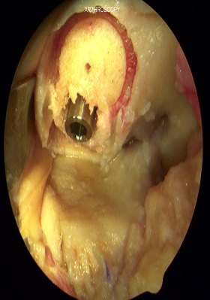
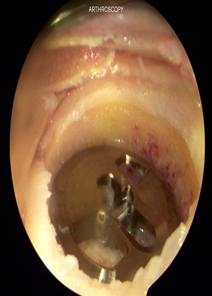
UniCAP – medial knee resurfacing

Slide 41
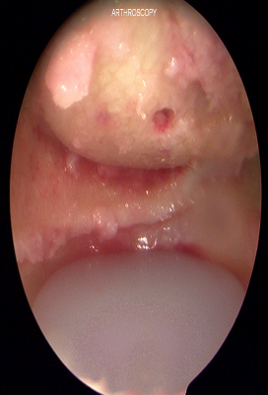
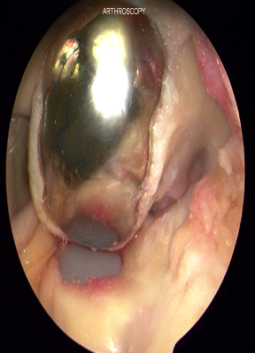
UniCAP – medial knee resurfacing

Slide 42
UniCAP – medial knee resurfacing

Slide 43
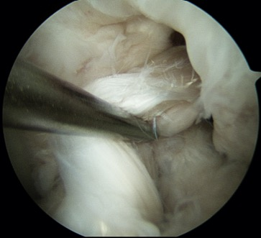
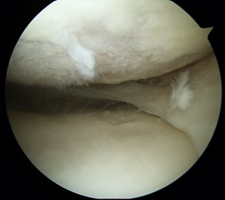
29yr female teacher, mom, skier
Failed 2nd ACL graft
Knee Unstable
Pain medial, lateral, anterior
Relevant details:
Osteophytes
Tibial cartilage damage
Tricompartmental
Degenerative, non-focal lesions
Prosthetic NOT Bio resurfacing

Slide 44
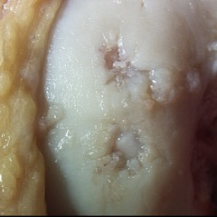
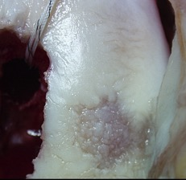
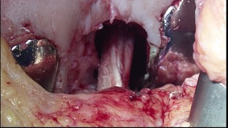
intra op
MFC
LFC
Planning and sequencing surgery:
Scope debride
ACL tunnels
Arthrotomy
LFC resurface prep
MFC resurface prep
Implant resurfacing devices
ACL graft passage and fixation
Closure

Slide 45
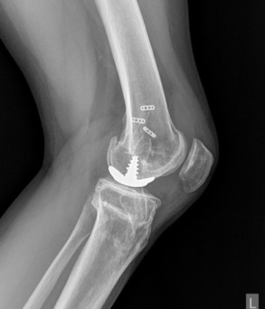
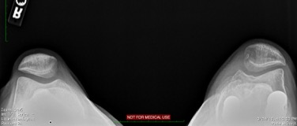
2 yrs post op

Slide 46
Case Report – 51 year old, failed Microfracture, unable to exercise due to medial knee pain

Slide 47
1 year post microfracture,no pain relief …excellent indication for Inlay Resurfacing

Slide 48
Minimum 5-year results of focal articular prosthetic resurfacing for the treatment of full-thickness articular cartilage defects in the knee. Becher, C. et.al. Arch Orthop Trauma Surg . DOI 10.1007/s00402-011-1323-4. June, 2011.
21 patients, mean age 54 yrs, minimum f-u 5 yrs, small focal unipolar lesions
KOOS scores improved significantly (P < 0.005)
pain (51.1 to 77.6),
symptoms (57.9 to 79.5),
ADL (58.8 to 82.4),
Sports (26.3 to 57.8)
Tegner activity level
improved significantly (P< 0.02) from 2.9 to 4.
SF-36(physical) increased by 15.2 to 46.9 compared to the preoperative value
16/21 of the would have the operation again.
Radiographic results:
solid fixation, preservation of joint space and no change in the osteoarthritic stage.

Slide 49
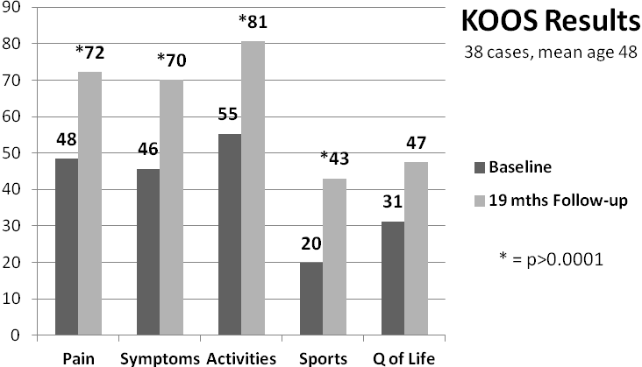
Inlay Arthroplasty: Tibiofemoral
Miniaci et al. ISAKOS 2011, Rio de Janeiro

Slide 50
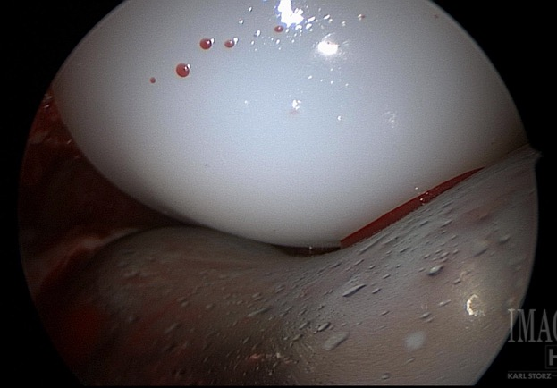
PFA (patellofemoral arthroplasty)

Slide 51
The HemiCAP® resurfacing platform technology … a new paradigm in joint resurfacing,
Based on intraoperative joint surface mapping
Restoration of complex geometric surfaces in a variety of morphologic and pathologic states.”
Davidson PA, Rivenburgh D.
Focal anatomic patellofemoral inlay resurfacing: theoretic basis, surgical technique, and case reports.
Orthop Clin North Am. 2008 Jul;39(3):337-46, vi.

Slide 52
Inlay vs Onlay Arthroplasty: Patellofemoral
Schöttle PB, Latterman C.
Therapie der patellofemoralen Arthrose beim jungen Patienten.
Arthroskopie Volume 23, Number 3, 215-223
Comparison of Prosthetic Designs
LEFT: Onlay PF Implant Adding 8mm CENTER and RIGHT: Inlay WAVE PF Implant without facet height changes

Slide 53
PFA- Inlay Resurfacing
Trochlea alone or Bipolar
Traditional, historic prostheses limited success and rarely used
Inlay device allows for concurrent re-alignment easily, as no overstuffing
Inlay device can handle very advanced PF DJD and morphologic variability
Hypoplastic, aplastic trochlea can be given concavity
Traditional PFA
Inlay PFA- FTG

Slide 54
Implant design reapproximates anatomy
Normalizes patellofemoral surface and knee contact pressures."
Provencher M, Ghodadra N, Verma N, Cole BJ, Zaire S, Shewman E, Bach B.
Patellofemoral Kinematics After Limited Resurfacing of the Trochlea.
J Knee Surg. 2009;22:310-316

Slide 55
Inlay Arthroplasty: Patellofemoral
van der Merwe et al. Patellofemoral Study Group Meeting 2011

Slide 56
Trochlear Implants Variety of Geometry

Slide 57
Patellar Implants Variety of Sizes/Shapes, Cemented

Slide 58
Our original case

Slide 60
Alignment

Slide 61
Post op. 3 yrs. Full ROM, VAS pain 0-2 with activities.

Slide 62
Inlay allows ample room for other procedures ( ACL reconstruction)

Slide 63
Technical Failure 38 yr old 9 mos post op - no pain relief from unipolar UniCAP synovitis, cartilage debris, UniCAPproud, tibial wear, FTG defect

Slide 64
Failure “normal” fibrous overgrowth, asymetric, proud

Slide 65
UniCAP removal- revision to UKA

Slide 66
“Ideal” First Patient for Inlay
30-60 yrs
Nearly normal alignment
Biologics not indicated
Unicompartmental disease (III b,c or IV)
“Staging” Scope or scope photos

Slide 67
Managing Utilization …..facilitating planning
Arthroscopic images are extremely helpful, if not critical
Chondral Fissures are key issue, cannot differentiate statically between stable and unstable grade III lesions….
MRI – 3T Fat Suppressed Fast Spin Echo, cartilage sequences
Have multiple surgical options available- difficult or expensive
Role for in-office diagnostic arthroscopy??

Slide 68
SHOULDER RESURFACING
Focal Defects
AVN
Instability Defects
Post Traumatic Arthrosis
Osteoarthritis

Slide 69
AVN-Operative

Slide 70
Humeral Head Defects Reverse Hill Sachs
Left Locked Post Dislocation

Slide 71
Degenerative Joint Disease

Slide 72
Sweet SJ, Takara T, Ho L, Tibone JE.
Shoulder - OA
20 shoulders
Mean follow-up period 32.7 mo
ASES: 24.1 to 78.8
Simple Shoulder Test: 3.95 to 9.3
VAS pain: 8.2 to 2.1
Forward flexion: 100° to 129°
External rotation: 23° to 43°
(P < .001 for all)
Patient shoulder self-assessment: 90% poor before surgery and improved to 75% good to excellent
Primary partial humeral head resurfacing: Outcomes with the HemiCAP implant.
Am J Sports Med. 2015 Mar;43(3):579-87.

Slide 73
HemiCAP for RCT and Osteoarthritis
73 y/o Male, Tennis player with a failed previous rotator cuff repair
Previous surgical findings of articular disease

Slide 76
Open Rev. RCR with Augmentation, HemiCap for RCT and Osteoarthritis
Post-op marked pain relief
Improved ROM
Marked decrease in pain

Slide 77
ANATOMIC INLAY RESURFACING FOR GLENOHUMERAL OSTEOARTHRITIS Clinical Results in a Consecutive Case Series

Slide 78
Surgical Technique
Anterior approach
Subscapularis take down
Capsular releases
Osteophyte resection on both humerus and glenoid
NO glenoid resurfacing or reaming

Slide 79
Demographic Data
N = 48
Males – 29
Female – 19
Mean age at surgery
61 years
Follow-up
Mean – 28 mos.
Max – 36 mos.
Min – 13 mos.
Side
Right – 19
Left - 14

Slide 80
HemiCAP in OA
Concurrent Procedures
Rotator Cuff Repair
12
Subacromial Decompression
25
Distal Clavicle Resection
23
Biceps Tenodesis
2
Biceps Tenotomy
21
Capsulolabral Repair
5
Hardware Removal
1

Slide 81
Simple Shoulder Test

Slide 82
VAS Pain

Slide 83
NO reported loosening of implant in the shoulder
No signs of
Device disengagement
Progressive periprosthetic radiolucency
Implant subsidence

Slide 84
2015 Australian Arthroplasty Registry
Lowest Revision Rate for HemiCAP
among all shoulder arthroplasty classes
HemiCAP
All Ages
Stemmed Hemi Arthroplasty
<55 --------------------->75 yrs
Stemmed Reverse Arthroplasty
<55 --------------------->75 yrs
HemiCAP Hemi Onlay Stemmed Hemi Stemmed Total Reverse
Hemi Onlay Resurfacing
<55 ------------->75 yrs
Stemmed Total Arthroplasty
<55 --------------------->75 yrs

Slide 85
Inlay Glenoid

Slide 86
Angled approach for spherical reaming
30°axis angle to slide past Humerus
30°

Slide 87
Inlay Glenoid Resurfacing
Off axis instrumentation
Access with head or implant in place
Full disposable kit
2 sizes for coverage
Total Shoulder Resurfacing

Slide 88
Pinkas D Wiater B Wiater JM
The inlay design permits partial resurfacing of the glenoid, leaving a peripheral rim of bone that potentially improves liftoff resistance and stability.
HemiCAP glenoid replacement system (Arthrosurface) an inset glenoid component.
The Glenoid Component in Anatomic Shoulder Arthroplasty.
J Am Acad Orthop Surg. 2015 May;23(5):317-326.

Slide 89
Advantages of Inlay Resurfacing
Immediate, excellent pain relief
Simple, canulated, reproducible, yet elegant surgery
Very few soft tissue balancing challenges
Minimally bone sacrificing
Minimal EBL, can be outpatient
Can easily convert to traditional or reverse arthroplasty
Patient acceptance
Allows concurrent soft tissue procedure
Maintain cartilage restoration principles
Based on patient, or ambient anatomy

Slide 90
Closing thoughts…..Joint Resurfacing
Minimize Perioperative morbidity
Retain future options – as much as possible
Resurfacing may be a bridging procedure
Maximize Outcomes
Equal, or better than traditional treatments
Offering additional options to patients that may have had few alternatives

Slide 91
Thank You phildavidsonmd@gmail.com davidsonorthopedics.com

